Slide 1
Network Security Detection
Yangxuan Wu
ywu1214@ilstu.edu
Supervisor: Dr. Yongning Tang
School of Information System
Illinois State University
December 2020
Notes:
Hello, everyone. My name is Wu Yangxuan. I am an autumn graduate from the School of Information Systems, majoring in network security and management.

Slide 2
Outline
Look at the big picture；
Get the data；
Prepare the data for Machine Learning algorithms；
Select a model and train it；
Score and Evaluate the algorithms;
Conclusion and Future Work
Notes:
This is the outline of the project, I will use this as the basis for a complete introduction of the project进入翻译页面

Slide 3
1. Look at the big picture
1.1 The project objective
1.2 Frame of the project
1.3 Select a Performance Measure
Notes:
In the big Picture part, it is mainly divided into three parts to describe: first, the goal of the project. I need to make clear what the purpose of this project is. Secondly, I designed an appropriate project framework to achieve my goal, including the selection of data sources, the processing of data, and the selection of algorithms. Finally, a method is designed to evaluate the algorithms used, and the performance of the algorithms in the network data prediction is analyzed according to the scores generated from the algorithm evaluation. Next, I'll describe the big picture in detail.

Slide 4
1.1 The project objective
A variety of representative machine learning algorithms are trained and predicted by using real network data.
These algorithms are evaluated and analyzed based on the predicted results.
In the learning process, try to understand the machine learning algorithms which used in project.
Notes:
The objective of this project is to train and predict a variety of representative machine learning algorithms using real network data. These algorithms are evaluated and analyzed according to the predicted results. During the learning process, try to understand the machine learning algorithms used in the project

Slide 5
1.2 Frame of the project
The project adopts supervised learning algorithms：The data set for the item contains labeled columns and is qualitatively classified as Attack and benign.
The project is a classification task:The predicted results of project requirements are attack and benign.
The project uses batch learning techniques:The data set of this project adopts offline data, so batch learning is used instead of online learning.
Notes:
The rage of the project is mainly divided into three directions. First, I adopted the supervised learning algorithm, because the data set of the project contains tag columns, which are qualitatively divided into attack and normal. Secondly, I defined the project as a classification task according to the characteristics of the data set, because the predicted results of the project requirements only fall into two categories: attack and normal. Finally, the project USES batch learning techniques: the project's data set USES offline data, so batch learning is used instead of online learning.

Slide 6




1.2 Select a Performance Measure
Accuracy: The ratio of successfully categorized data to total data;
Recall (Sensitivity): The ratio of data classified as an attack to all attack data;
Precision: The ratio of successful classified data as the attack to all data classified as the attack;
F-measure (F-score/F1-score): The harmonic-mean of sensitivity and precision. This concept is used to express the overall success. So, in this study, when analysing the results, it will be focused, especially on the F1 Score.
Accuracy: The ratio of successfully categorized data to total data;
Recall (Sensitivity): The ratio of data classified as an attack to all attack data;
Precision: The ratio of successful classified data as the attack to all data classified as the attack;
F-measure (F-score/F1-score): The harmonic-mean of sensitivity and precision. This concept is used to express the overall success. So, in this study, when analysing the results, it will be focused, especially on the F1 Score.
Notes:
The results of this study were evaluated according to four criteria, namely accuracy, precision, F-measure and recall rate. All of these conditions have values between 0 and 1. As it approaches 1, performance increases, and as it approaches 0, performance degrades.

Slide 7
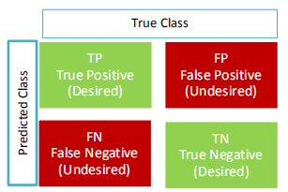
1.2 Select a Performance Measure
In calculating these four items, the four values summarized below are used:
TP: True Positive (Correct Detection) The attack data classified as attack
FP: False Positive (Type-1 Error) The benign data classified as attack.
FN: False Negative (Type-2 Error) The attack data classified as benign.
TN: True Negative (Correct Rejection) The benign data classified as benign.
Notes:
There are four variable values in the principle formula to calculate these four standards, among which TP: is true and positive, that is, the input attack data is accurately classified as attack, FP: false positive, that is, the input benign data is misclassified as attack. FN: False negative, in which the incoming attack data is misclassified as benign. TN: True negative, that is, the benign data of the tree is correctly classified as benign.

Slide 8
2. Get the data
2.1 Create the Workspace；
2.2 Choose the datasets；
2.3 Anomaly and Attack types in datasets;
Notes:
Ok, after the introduction of the first part, I have a big framework for the project in mind. Now, I will start to practice the specific content of the project. First, I will determine the data. In this part, I will work in three parts. First, you need to create a workspace, or code running environment. Secondly, I need to choose an appropriate data set. Finally, I need to understand the types of exceptions and attacks in the data based on the data set in principle. Now, let's take a collective look:

Slide 9
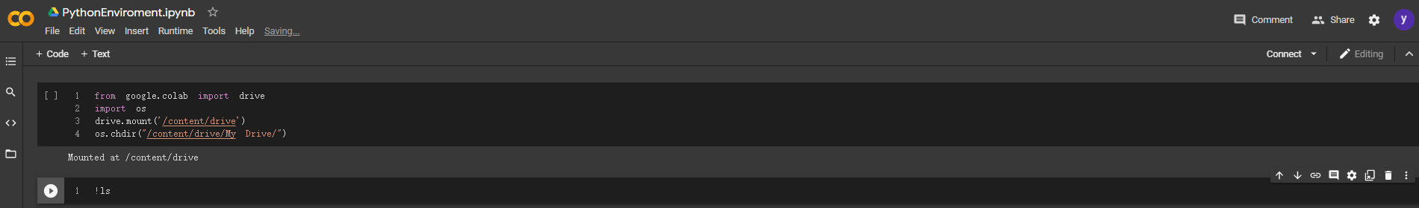
2.1 Create the Workspace
Use Google Colaboratory and Google Drive to be operating enviroment of the project
Notes:
This project will use Google Colab as the Python running environment and Google Drive as the channel to import and export data.

Slide 10
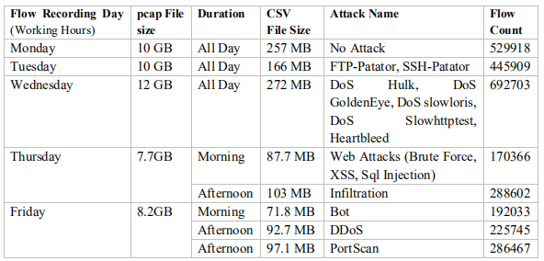
2.2 Choose the datasets
CICIDS 2017(Intrusion Detection Evaluation Dataset）
created by the Canadian Institute for Cybersecurity at the University of New Brunswick；
This dataset consists of a 5-day (3rd July- 7th July 2017) data stream on a network created by computers using up-to-date operating systems such as Windows Vista / 7 / 8.1 / 10, Mac, Ubuntu 12/16 and Kali；
Details of the dataset can be seen from the table below:
Notes:
On the choice of data sets, I will decide to choose CAIDA (Internet application data analysis center) network data, released in 2017 randomly selected data from Monday to Friday, is composed of eight CSV file, as the data set is used during the implementation phase, because the data set is relatively new, and provides a wider agreement and pool, a representative sample. In addition, since the amount of work done online with the data set is still small, the experience generated from using the data set can be considered a potentially important contribution. So, let's take a concrete look at the advantages of this data set:

Slide 11
2.2 Choose the datasets
Advantages of CICIDS2017 are the following:
The obtained data is the real-world data; was obtained from a testbed consisting of real computers.
Data streams are collected from computers with the up-to-date operating system. There is operating system diversity (Mac, Windows, and Linux) between both attacker and victim computers.
Data sets are labelled. In order to apply the machine learning methods, the feature extraction, which is a critical step, was applied and 85 features were obtained.
Both raw data (pcap files - captured network packets files) and processed data (CSV files_x0002_comma-separated data files) are available to work on.
In the course of deciding which attack to take place, the 2016 McAfee security report was used, so there is a wide and up-to-date assortment of attacks.
It is more abundant than other data sets in terms of protocols used. It also includes the HTTPS (Hypertext Transfer Protocol Secure) protocol in addition to FTP, HTTP, SSH and e-mail protocols.
Notes:
This data set has the following advantages: 1. It is real world data collected by Internet Application Data Analysis Center, an organization engaged in Internet data analysis, with authority and reliability 2.There is operating system diversity (Mac Windows and Linux) 3 between the attacker and the victim computer from which the data stream is collected on the computer with the latest operating system.The main task of marked data set project is to study the performance of supervised learning algorithm against network data, so I need network data set with label, which is helpful for me to apply machine learning method to practical work 4.This dataset has a wide range of relatively new types of attacks, it is much richer than other datasets in terms of the protocols used. It also includes HTTPS(hypertext Transfer Protocol Security), FTP, HTTP, SSH, and E-mail protocols and has up to 85 feature values so it can effectively represent the current network environment

Slide 12
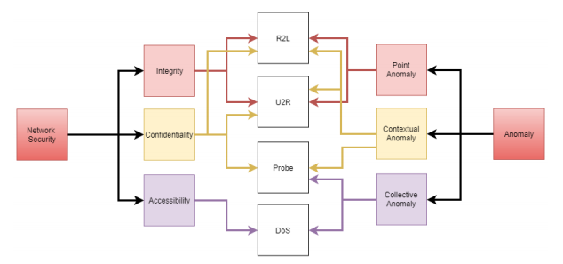
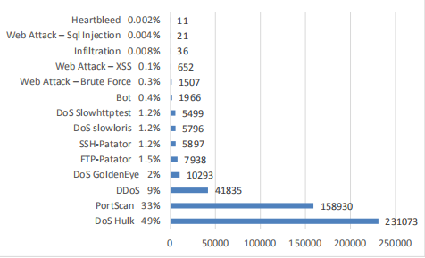
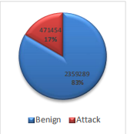
2.3 Anomaly and Attack types in datasets;
Anomaly and attack types
Anomaly Types
Network Attacks Types
Attacks in the dataset
Notes:
An exception is a sample that does not have the well-defined nature of a normal sample. In order to understand the exception, the rules that make up the normal concept must be specific and valid to analyze the exception under three headings: 1.Point exceptions: If a particular data sample looks different from the entire data set of attributes it carries, it is called a point exception [11]. For example, if a person makes a small number of purchases per day with a credit card, he makes a large number of purchases in any given day, which is a point exception 2.Context exception: The non-pattern behavior of the data sample depends on or occurs under certain conditions. For example, if a person makes few purchases with credit CARDS every day, he will make a high amount of purchases on the holiday day. This is a context exception.Collection exceptions: If a data heap composed of similar data has abnormal properties based on normal data, it is called collection exceptions. For example, the increase in Valentine's Day credit card spending is a collective anomaly. Network security tries to protect the network from three principles: confidentiality integrity and availability.The cyber attack is an attempt to destroy these three basic characteristics of the attack can be summarized into four headings: 1.Denial of service (DoS) : in this type of attack, the attacker misuse of system resources, prevent legitimate users is the most simple example of using the services through to a web server sends a large number of requests to make it out of service DoS attacks can be divided into two parts, the bandwidth consumption and wastage of resources consume bandwidth goal is to provide very high data flow through to consume the bandwidth of the victim, and resource depletion attack is usually through a lot of package to burn off the victim's memory and processor resources such as 2.Probe (information collection) : these attacks are designed to collect information of the target in this attack, an attacker can get a lot of important information, such as network structure used by the operating system types and characteristics of network equipment such as though the attack does not directly affect the system, but it is very important, because it is ready for many possible attack damage system 3. The U2R (user to root) : in this type of attack, the attacker attempts to gain control of the management account, in order to access and steal important resources system vulnerabilities or attacker may use a brute force attack to gain administrator account 4. R2U /R2L(remote to user/remote to local): In this type of attack, the attacker infiltrates the victim's network to gain the privilege of sending packets from the victim's computer. The attacker can use system vulnerabilities or brute force attacks to gain this privilege

Slide 13
3.Prepare the data for Machine Learning algorithms
3.1 Data Cleansing
3.2 Statistics of the dataset
3.3 Creation of Training and Test Data
3.4 Feature Selection
Notes:
The process of preparing data for machine learning algorithm can be generally divided into three parts: first, data shall be standardized, commonly known as data cleaning; second, original data shall be split to create training set and test set; the last part is the selection of features, all of which are the preparation work before algorithm training

Slide 14
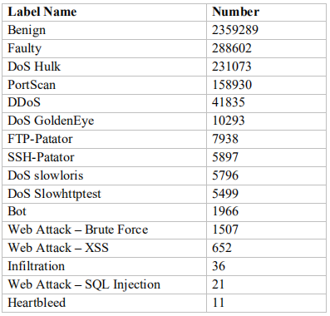
3.1 Data Cleansing
Notes:
Before actual use data set may be necessary to make some changes to data sets, and make it more effective for this purpose, this section of CICIDS2017 some defects in the correction of data set, and the partial data edit data set file contains 3119345 record the flow of the flow distribution of see chart when check the records, you can see the 288602 record is incorrect/incomplete 3 pretreatment process of the first step is to remove the unnecessary record data set is another mistake in the composition characteristics of the columnData set file is composed of 86 columns, the columns defined flow properties, such as flow ID source IP source port but the Fwd header length features (which defines the total bytes of data flow forward) is written twice (column and column 62 41) by removing duplicate column (column 62) needs to be done to correct this error data set of another change is that will include the category value and a string value (stream ID source IP destination IP timestamp external IP), is converted to a digital data attributes, in order to machine learning algorithms used in this can be achieved by SklearnClasses of LabelEncoder () to achieve this, all cannot be used for machine learning operation string values are between 0 and n - 1 integer values, and more suitable for processing, however, although the Label tag is a classification feature, but did not make any changes to it because in the process, in order to classify different forms of attack, trying different methods, need the original category in the end, a few small structural changes to the data set, including: tags, character (Unicode decimal code #8211) is used to identify the network attack subtypes (web a brute force attack, web - XSS attacks, network attack - SQL injection) must be replaced character (Unicode decimal code, # 45), from utf-8, panda default encoding libraries, don't admit it otherwise, panda library will not know this character, it will fail Flow Bytes/s Flow packet/s characteristics besides numerical include numerical Infinity and NaN, can be modified to -1 and 0 respectively to make it suitable for machine learning algorithms

Slide 15
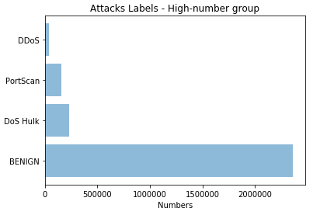
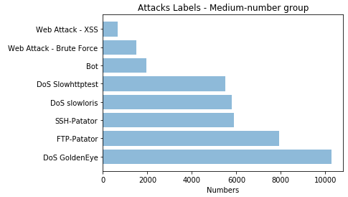
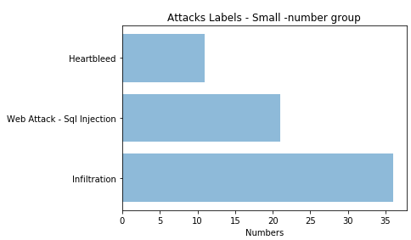
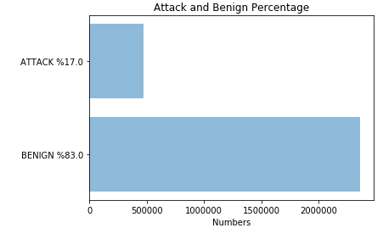
3.2 Statistics of the dataset
Notes:
This step adds up all the individual attack files to a single table, with the labels column, as all_data.csv. And according to the frequency of attacks in the tag, it is divided into three groups. The purpose of this step is to understand the proportion of attack types and attacks in the data set, deepen the understanding of the data set, and prepare for the subsequent steps.

Slide 16
3.3Creation of Training and Test Data
Generally preferred partitioning is 20% test, 80% training data [40] and this ratio is also preferred in this application. The train_test_split command makes the selection random when creating data groups.
This process is known as cross-validation. In order to ensure that the results obtained during the application are solid, the creation of the training and the test data have been performed 10 times in succession. The results obtained are the arithmetic mean of the repeated operations.
Cross Validation
Notes:
In machine learning, you need data to learn. The data set used is the result of this need. In addition to the data needed for training, you also need test data to evaluate the algorithm's performance and see how well it works. The algorithm takes a skill from the training data and applies it to the test data. The result of the test data is the performance of the machine learning algorithm; however, the CICIDS2017 data set used does not contain dedicated training and test data, but contains a separate unbound data set. Therefore, the data should be divided into training data and test data. In the application phase, use the Sklearn command train_test_split. This command divides the data into two parts according to the size specified by the user. Usually the preferred partition is 20% test and 80% training data, which is also preferred in this project. The train_test_split command makes the selection random when creating a data group. This process is called cross-validation. In order to ensure that the results obtained during the application process are reliable, 10 training and test data creation were conducted consecutively. The result is the arithmetic mean of the repeat operation. To help you understand this part of data processing, I'm going to talk a little bit about cross-validation.

Slide 17
Cross Validation
cross_val_score from sklearn
Advantages
Cross-validation is used to evaluate the predictive performance of the model, especially the performance of the trained model on the new data, which can reduce the overfitting to some extent.
Get as much useful information as possible from the limited data.
Notes:
Cross-validation is used to evaluate the predictive performance of the model, especially the performance of the trained model on the new data, which can reduce the overfitting to some extent. You can also extract as much useful information as possible from the limited data.

Slide 18
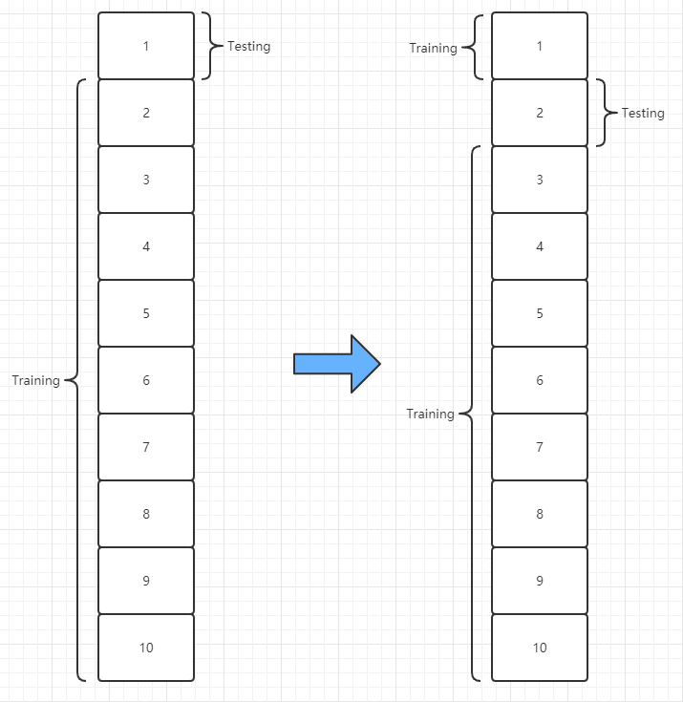
Cross Validation
Notes:
Let me give you a simple example of how cross-validation works. For example, above, we split the data set into 10 folds, do a cross-validation, and it actually computes 10 times, treating each fold as a test set, and the other 10 folds as a training set, and so on for 10 cycles. After ten times of training, the results of the ten times were averaged through the passed model. Each data set is then computed once more. This is the processing of data in cross-validation. The advantage of doing this is that you can get as much effective information as possible from the limited data and ensure that the results obtained in the application process are reliable.

Slide 19
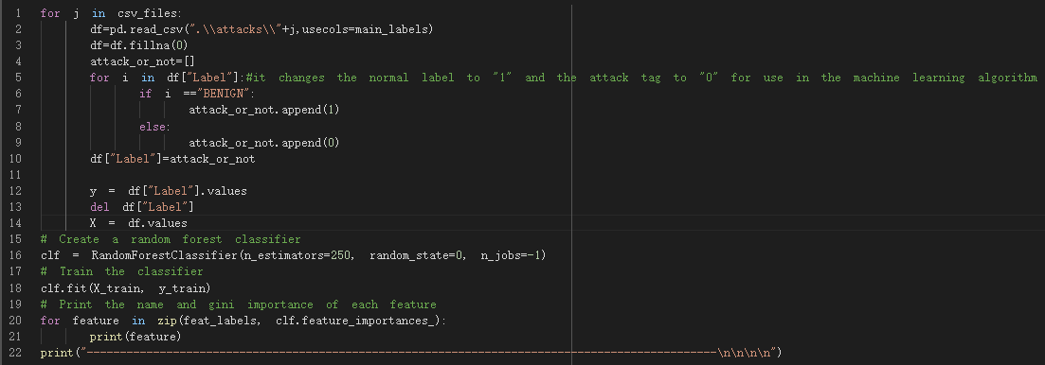
3.4 Feature Selection
Feature Selection According to Attack Types
Notes:
Sklearn's random forest classifier is used to calculate the importance weights of features. This algorithm creates a decision forest. In this decision forest, each feature has an important weight in the construction of the decision tree. After processing, the important weights of these features are compared and sorted. The sum of the important weights of all the attributes is the total important weight of the decision tree. By comparing the scores of any feature with the scores of the whole tree, information about the importance of the feature in the decision tree can be obtained. In this part, the training of random forest classifier is carried out by using all the data sources with separate attacks, and the weight of each feature is obtained according to the type of attacks.

Slide 20
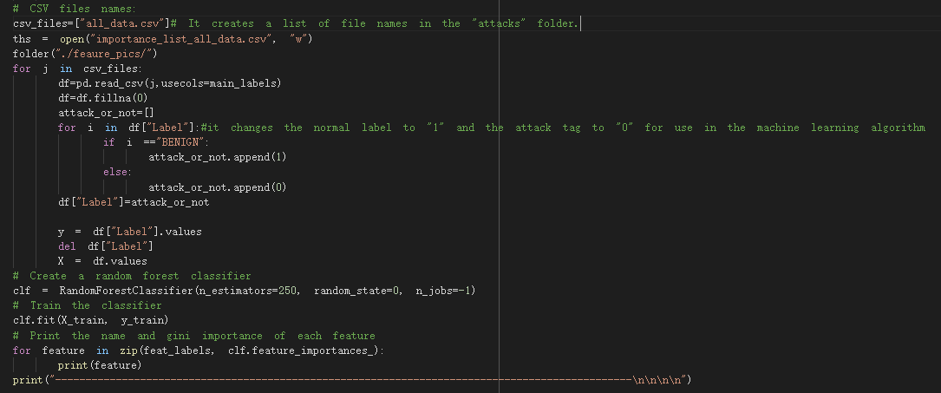
3.4 Feature Selection
Feature selection based on attack or benign
Notes:
In this step, all_data.CSV data is used to train the random forest classification algorithm according to the tag column, and the weight of each feature is obtained. Feature extraction method and principle of specific, I will stay in algorithm part, explain the random forest.

Slide 21
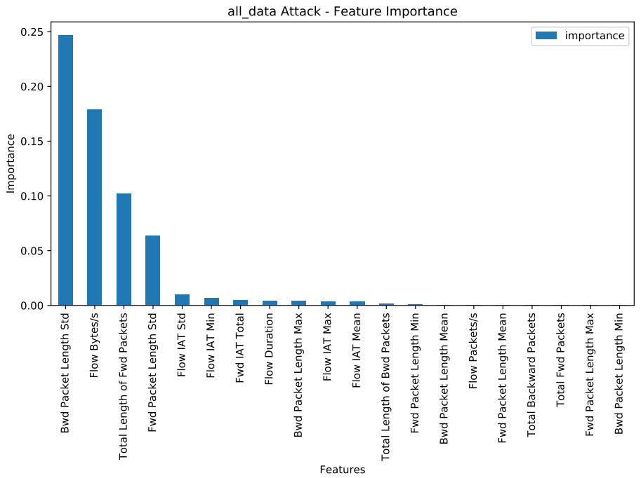
3.4 Feature Selection
The result of feature selection in all_data.csv
Notes:
here is the ranking of weights from large to small after feature extraction of all_data.CSV data set.

Slide 22
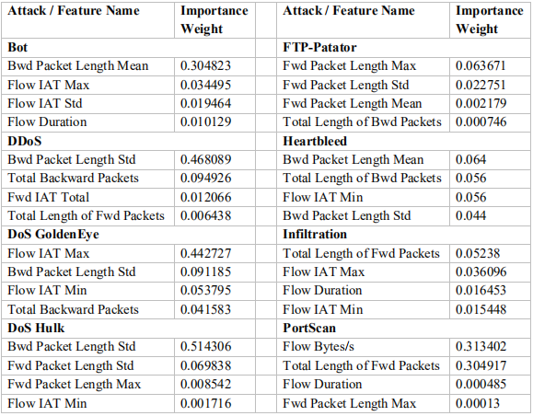
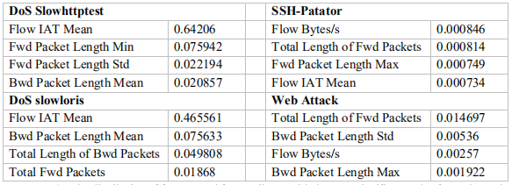
3.4 Feature Selection
The result of feature selection in the dataset of each attack.
Notes:
Here, feature weights are calculated for each type of attack data, and the four highest weights are extracted by sorting them from the largest to the smallest.

Slide 23
4.Select a model and train it
Choose machine learning
Decision Tree
Random Forest
AdaBoost(adaptive Boosting)
Gaussian Naive Bayes
KNN(K Nearest Neighbour)
MLP(Multi-Layer Perceptron)
QDA(Quadratic Discriminant Analysis)
Perceptron
LinearSVC（Linear SVM algorithm）
Notes:
The data processing has been completed, and the specified machine learning, monitoring algorithms will now be fitted and predicted. Here are nine representative supervised learning algorithms I have chosen.

Slide 24
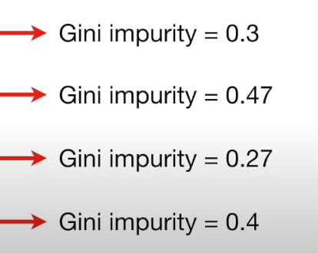
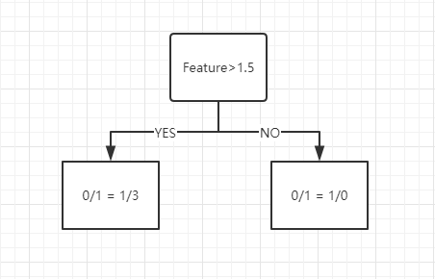
Decision Tree
Feature 1 | Label
1 | 0
2 | 1
3 | 0
4 | 1
5 | 1
Steps:
1. Arrange the value of feature from small to large;
2. Calculate the average value of each two values of the feature;
3. Calculate the Gini impurity score for each mean. Gini coefficient reflects the probability that two samples are randomly selected from the sample set with different categories. Therefore, the gini impurity is used as the indicator of Gini coefficient.
( Gini impurity = 1 - (the probability of “0”) - (the probability of “1”) );
4. The minimum value of Gini impurity score of mean is taken as the value of this feature.
(1+2)/2=1.5
(2+3)/2=2.5
(3+4)/2=3.5
(4+5)/2=4.5
Total Gini(Feature1) = 4/(4+1) * 0.336 + 1/(1+4) * 0 = 0.3
...
Gini = 0.336
Gini = 0
Notes:
The first is a decision tree is a decision tree can be used for classification and regression of the core components of the decision tree of data structure is the root node internal nodes and leaf nodes they are using the gini coefficient as the basis of division of the following is the working principle of decision tree, the first thing we need to do is to determine the root node of the decision tree, because it is the starting point of the decision tree, start all internal nodes from the root node and extension of the determination of the root node usually has four steps:The first step is computed the characteristics of the training focus here, extracted from the left side of the list, for example, we need to value since the childhood of Feature1 is arranged in the second step, we need to calculate every two adjacent features of the third step is to calculate the average value of the average Gini score of impurities of Gini coefficient to reflect was never the same sample concentration of random probability of two samples of the Gini coefficient, the greater the never similar other randomly selected sample concentration the greater the probability of two samples, the purity of the sample is smaller, therefore, this article USES the Gini index of impurities as the Gini coefficientGini coefficient is higher, the greater the classification error of two samples, therefore, in this case, we need to take the principle of lower purity of Gini operate please look at the lower left corner, when Feature is greater than 1.5 and to NO, attack the determination results for collection categories, Gini purity is 0, the error is 0 finally take the mean score of the minimum Gini impurities as the characteristic values

Slide 25
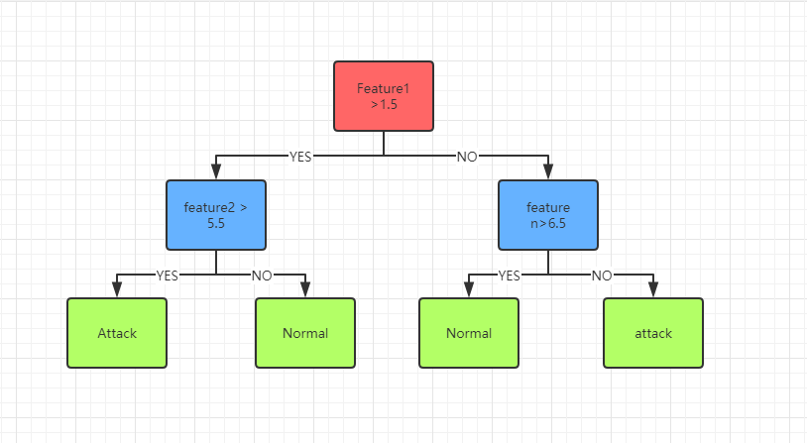
Decision Tree
eg. If Gini(feature 1) = 3.5 < Gini(feature 2) = 5.5 < Gini(feature n) = 6.5, feature 1 will be the Root Node. feature2 will be the second node. And we can use the terms of the value of feather1 on the same row as the value of feather2 to decide whether we're going to split to the left or the right. Finally, Leaves will be the end. point.
Feature1 | ... | Feature n | Label
1 | ... | 6 | 0
2 | ... | 7 | 1
3 | ... | 8 | 0
4 | ... | 9 | 1
5 | ... | 5 | 1
Notes:
Ok, we have calculated all the features of Gini impurities, so we can use the principle of selecting the least purity to select the root node and subsequent internal nodes. For example, if Gini(feature 1) < Gini (function 2)& LT; Gini(feature n), feature 1 will be the root node. Feature2 will be the second node. We can use the value of feather1 and the value of Feather2 on the same line to decide whether we want to split to the left or to the right. Each path starting from the root node, after two node screening, will obtain the highest purity classification, this node is the leaf node. Therefore, the process of spreading the branches and leaves of the decision tree is the process of gradually improving the classification purity.

Slide 26
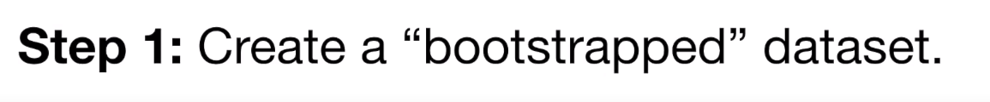
Random Forest
Feature1 | ... | Feature n | Label
1 | ... | 6 | 0
2 | ... | 7 | 1
3 | ... | 8 | 0
4 | ... | 9 | 1
5 | ... | 5 | 1
Feature1 | ... | Feature n | Label
2 | ... | 7 | 1
2 | ... | 7 | 1
3 | ... | 8 | 0
1 | ... | 6 | 0
5 | ... | 5 | 1
Notes:
After introducing the decision tree, I will introduce the random forest, because it is based on the decision tree, constructing multiple decision trees to generate a classification algorithm. First of all, there are two random sampling processes. Random forests require sampling of input data and columns. Row sampling adopts the method of putting back, that is, there may be duplicate samples in the sample set obtained by sampling. The new example must ensure that the number of rows and columns and the table header are the same as the original table.

Slide 27
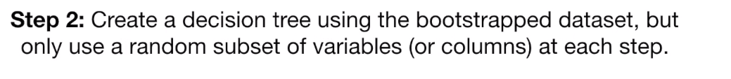
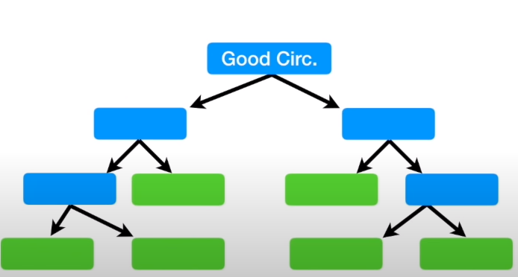
Random Forest
Feature1 | ... | Feature n | Label
2 | ... | 7 | 1
2 | ... | 7 | 1
3 | ... | 8 | 0
1 | ... | 6 | 0
5 | ... | 5 | 1
Feature n
Notes:
The newly created random list, we need to use it to generate these lists, for each function, the use of decision tree data set is created by random list before, so each use feature list is different, the process of creation is explained in detail in my decision tree algorithm, here does not need to do a lot of work.

Slide 28
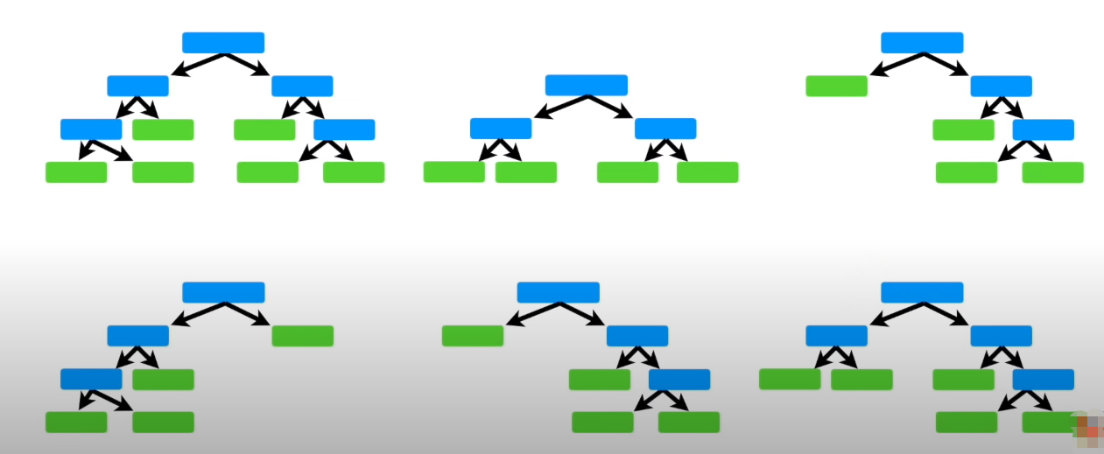
Random Forest
Step3 Use the random forest
Feature 3
Feature 1
Feature 2
Feature 4
Feature 5
...
Feature n
Notes:
The decision tree for each feature is trained from the root node. If the termination condition is reached on the current node, the current node is set to a leaf. If it is a classification problem, predict the type of the output leaf node and the maximum number of samples of the current node set.if regression problem, predict the average value of the output of each sample value in the current node example set.if the current node does not meet the termination condition, the function of selecting random characteristics has not been put back, and the training continues. The termination conditions mentioned here are the number of N_estimators for the decision tree, the depth of the decision tree, max_depth, and so on, which can be set during modeling.

Slide 29
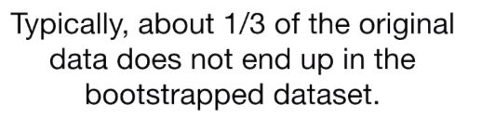
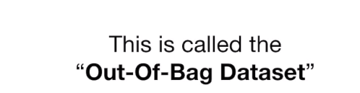
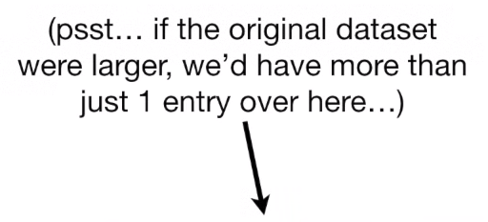
Random Forest
Step 4: They will beecome the test dataset to estimate the forest.
Feature1 | ... | Feature n | Label
Notes:
In the process of fitting the random forest model, 1/3 of the original training data is not used because the training list is repeatable. This type of data is called an out-of-package data set and can be used as a test set.

Slide 30
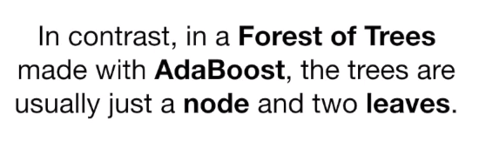
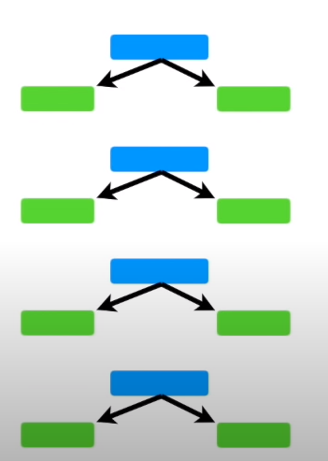
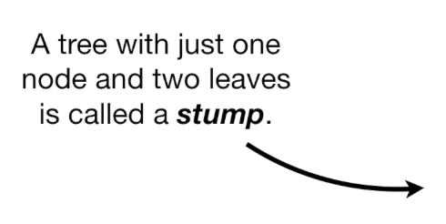
AdaBoost
Notes:
The full name of AdaBoost is Adaptive Boost, which means it is an algorithm that ADAPTS to itself and improves the performance of classification. Its self-adaptability lies in that the weight of the misclassified samples of the previous basic classifier will increase, while the weight of the correctly classified samples will decrease, and then it can be used to train the next basic classifier. At the same time, a new weak classifier is added in each iteration, and the final strong classifier is not determined until a predetermined small enough error rate or a predetermined maximum number of iterations is reached. The error rate and maximum number of iterations can be set at modeling time.

Slide 31
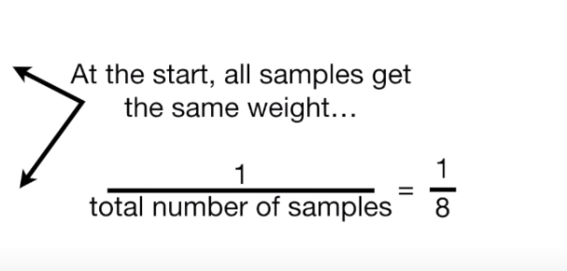
AdaBoost
Feature1 | ... | Feature n | Label | WEIGHT
1 | ... | 6 | 0 | 1/5
2 | ... | 7 | 1 | 1/5
3 | ... | 8 | 0 | 1/5
4 | ... | 9 | 1 | 1/5
5 | ... | 5 | 1 | 1/5
1/5
Notes:
First, we need to initialize the weight distribution weights of the training data. If there are N training sample data, each training sample is initially assigned the same weight: weight =1/N.

Slide 32
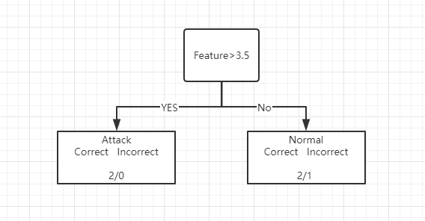
AdaBoost
Feature1 | ... | Feature n | Label | WEIGHT(TOTAL ERROR)
1 | ... | 6 | 0 | 1/5
2 | ... | 7 | 1 | 1/5
3 | ... | 8 | 0 | 1/5
4 | ... | 9 | 1 | 1/5
5 | ... | 5 | 1 | 1/5
Gini = 0
Gini = 0.444
Gini impurity = 1 - (the probability of correct) - (the probability of incorrect)
Total Gini(Feature1) = 2/(4+1) * 0 + 3/(1+4) * 0.444 = 0.333
...
Notes:
Through the calculation and selection method of ginI impurity in the decision tree, the weak classifier with the lowest error rate was selected as the first pile, in which ginI impurity was the error rate.

Slide 33
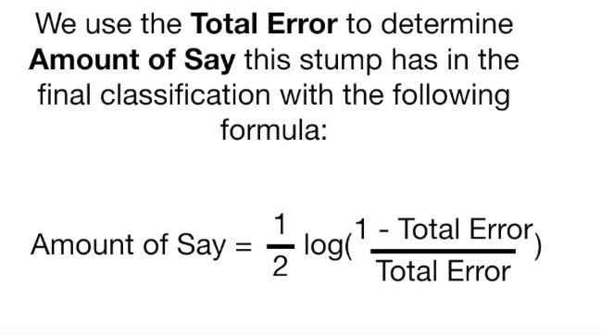
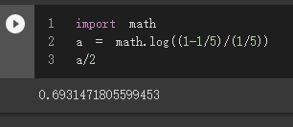
AdaBoost
Amount of Say(Feature1) = 1/2 * log[(1-1/5)/(1/5)] = 0.693
...
Amount of Say(Feature n) = 1/2 * log[(1-Total Error/Total Error]
Notes:
Then we need to train the weak classifier. The specific training process is as follows: if a training sample point is accurately classified by a weak classifier, then the weight corresponding to the next training needs to be reduced. Conversely, if a training sample point is misclassified, its weight should be increased. The weighted updated sample set is used to train the next classifier, and the whole training process is iterative. Here, the parameter that determines whether the weight value decreases or increases in the next iteration is Amount of. Its calculation is shown here and Feature1 is used as an example calculation.

Slide 34
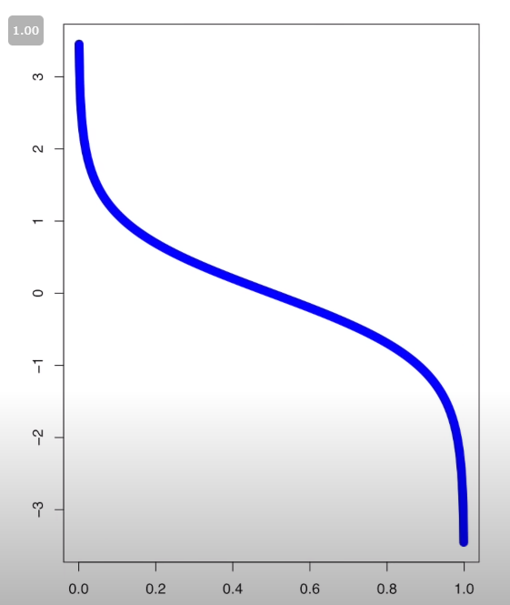
AdaBoost
Amount of Say
The Blue Line tells the Amount of Say for Total Error values between 0 and 1.
(Weight) total Error
Notes:
The relationship between the error and the amount of Say is given here. As can be seen from the figure, error =0.5 is the cut-off point. When the error value is less than 0.5 and close to 0, the Amount value of Say will be higher. When the error value is greater than 0.5, the Amount value of Say is negative, in other words, this indicator has no right of discourse.

Slide 35
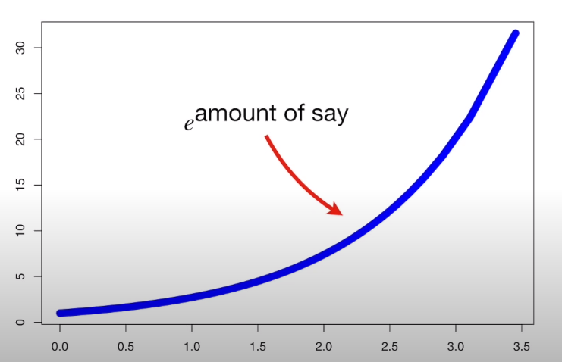
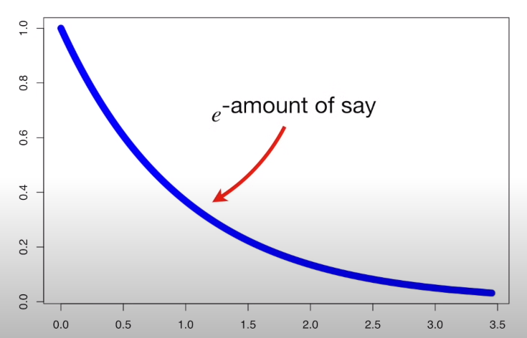
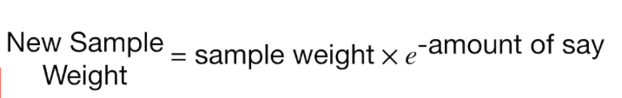
AdaBoost
Increasing the weight of bad sample:
New Sample Weight = old sample weight *
Decreasing the weight of good sample:
Notes:
Here, I'll show you how to increase and decrease the error weights. The X-axis represents the original error weight, and the Y-axis represents the added or reduced error weight. The blue curve is e to the power of quantity and e to the power of one over quantity.

Slide 36
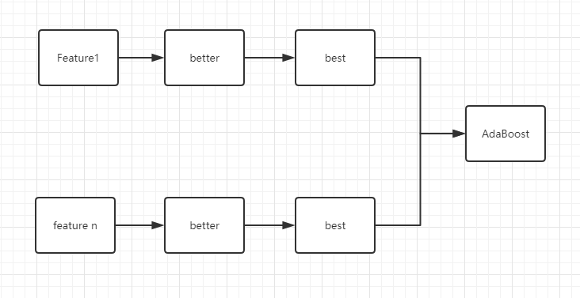
AdaBoost
.
.
.
......
Notes:
Here, I use only the two features shown in the example to demonstrate the iterative evolution of each stump. Evolution completes each feature of the weak classifier will eventually form a strong classifier. The value of say of each weak classifier determines its weight in the final classifier.

Slide 37
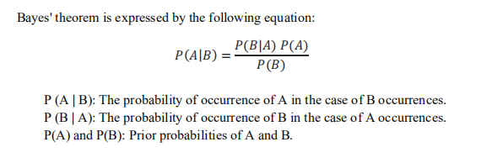
Gaussian Naive Bayes
1.The algorithm is used to adjust the value of feature, and its numerical distribution is fitted to the normal distribution.(The normal distribution curve is determined by the mean value and standard deviation of feature);
2.In the test set, reference tag values make independent assumptions.The probability of independent events is calculated according to the following formula. The large probability value is the output.
For the easy understanding, we no longer use event A and event B, but use the X and y commonly used in machine learning:
P(y|X)=[P(X|y)P(y)]/P(X)
Notes:
The Gaussian Naive Bayes algorithm adjusts the eigenvalues so that their numerical distribution conforms to the normal distribution. If x is multidimensional, then P(X1, |y), P(X2, |y)... The events corresponding to P(Xn|y) are independent of each other. Multiply these values to get P(X|y), which is the classification result.

Slide 38
Gaussian Naive Bayes
Feature 1 | ... | Feature n | Label
1 | ... | 6 | 0
3 | ... | 8 | 0
Feature1 | ... | Feature n | Label
1 | ... | 6 | 0
2 | ... | 7 | 1
3 | ... | 8 | 0
4 | ... | 9 | 1
5 | ... | 5 | 1
→
Feature 1 | ... | Feature n | Label
2 | ... | 7 | 1
4 | ... | 9 | 1
5 | ... | 5 | 1
Notes:
Here, I still use the example I used to explain the entire algorithm implementation. First of all, for the training set, the algorithm USES the value of Label to classify, here are 0 and 1, namely attack and Normal. The training data is divided into two sub-tables based on the indexes of these two items.

Slide 39
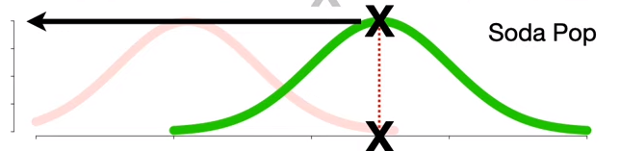
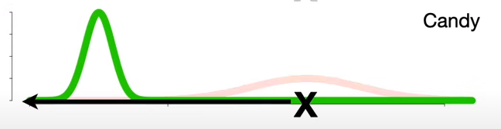
Gaussian Naive Bayes
Feature 1
Feature n
Attack/Label = 1
P(attack)*P(F1|attack)*...*P(Fn|attack)
......
Feature n
Not Attack/Label = 0
Feature 1
P( not attack)*P(F1|not attack)*...*P(Fn|not attack)
Notes:
For the two subtables, calculate P (X|y) for each feature, and the numerical distribution follows the gaussian distribution. In this case, I'm just showing the distribution of characteristic 1 and characteristic N. In this figure, X is the eigenvalue, and Y is the conditional probability of the eigenvalue P (X| Y). At this point, the training of the algorithm is completed. When there is training data input, the training data are calculated as attack probability and normal conditional probability respectively. The formula is given here. Compare the values of the two conditional probabilities and choose the larger one as the output.

Slide 40
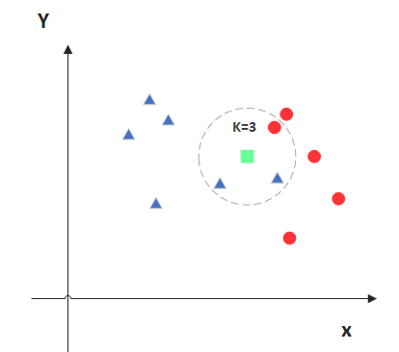
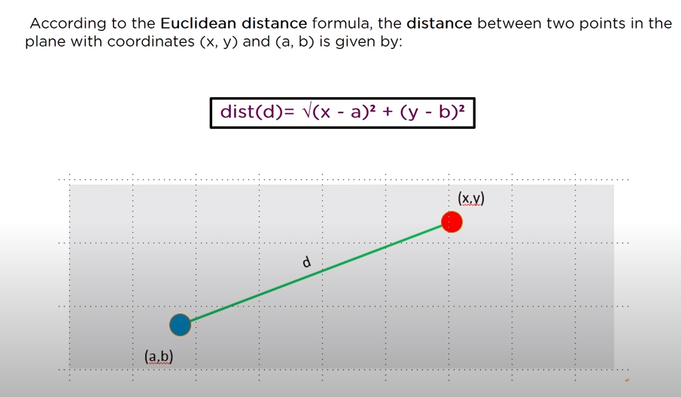
K Nearest Neighbour
Feature1 | Feature 2 | Feature 3 | Label
1 | 3 | 6 | 0
2 | 2 | 7 | 1
3 | 6 | 8 | 0
4 | 4 | 9 | 1
5 | 8 | 5 | 1
Notes:
KNN is arguably one of the simplest classification algorithms, and I'll stick with the previous example here. Assuming that three features are involved in the fitting, the values of these three features will appear in this case in a two-dimensional graph. The lower half of the figure gives the calculation formula of Euclidean distance between two points. The green point in the figure represents the point in the unknown test set, and K value is set to 3, that is, the nearest three points near the green point are selected, among which there are two blue points and one red point, and the property of the green point is blue.

Slide 41
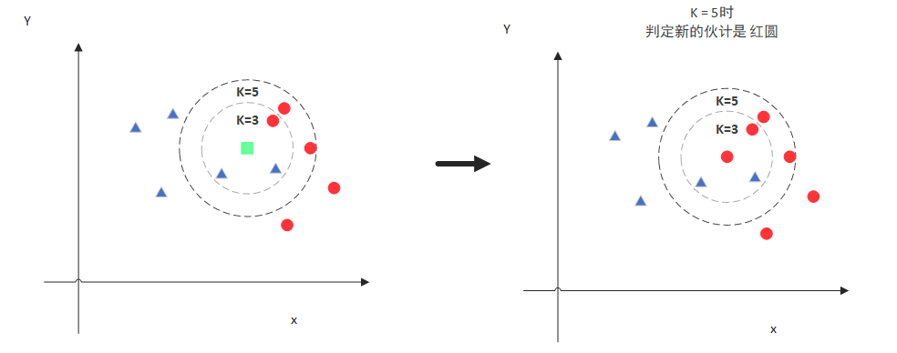
K Nearest Neighbour
If K=5, the new blue point is belong to red because the number of red points are more than blues' in K =5
Notes:
I'm going to continue with this example, when K is chosen 5, the new blue dot is red because there are more red dots than blue dots in K =5.

Slide 42
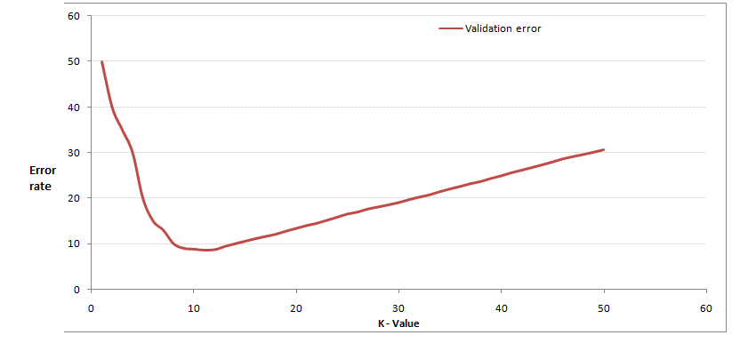
K Nearest Neighbour
Notes:
We know from the figure above that K is important, so how do we know what K is?The answer is through cross-validation (the sample data will be divided into training data and the use of validation data in a certain proportion, such as 6:4 to split a part of training data and test data), from the selection of a smaller value K,And then calculate the variance of validation set, and finally found a more suitable K value calculation of variance of cross validation after you get below this figure would be easy to understand, as you increase K, general error rate will be reduced, because there are more samples can be for reference will be better classification effect, but note that with K - means that when the K value is larger, the error rate is higher, it is easy to understand, for example, you are a total of 35 samples when you increased to 30 K, but meaningless basically choose K point can choose a larger point K, when it continues to increase/decrease error rate will rise, as shown in figure of K = 10

Slide 43
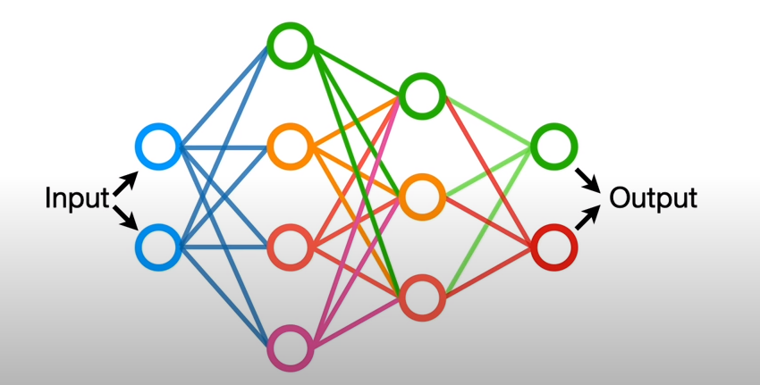
MLP
MLP is a type of artificial neural network.
Artificial neural networks (ANN) are a method of machine learning inspired by the way the human brain works.
The purpose of this method is to mimic the characteristics of the human brain, such as learning, decision-making and acquiring new information.
Notes:
MLP is also known as ANN(artificial neural network). In addition to the input and output layers, it can also have multiple hidden layers in the middle. The simplest MLPS contain only one hidden layer, a three-layer structure. The diagram shown here has two hidden layers, the first with four nodes/cells and the second with three.

Slide 44
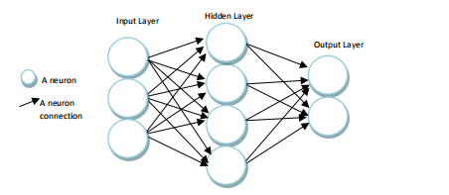
MLP
The input layer is the stage where the MLP is responsible for receiving data.No information processing is performed at this level.Only the information received is transmitted to the next layer, the hidden layer.
In the hidden layer, the data sent from the input layer is processed and transmitted to the next layer, the output layer.
In the output layer, which is the last layer, each cell is tied to all the cells in the hidden layer, and the results of the processed data in the hidden layer are served at this stage.
Notes:
The input layer is the stage where the MLP is responsible for receiving data. No information processing is performed at this level. Only the information received is transmitted to the next layer, the hidden layer. In the hidden layer, data sent from the input layer is processed and transmitted to the next layer, the output layer. At the output layer, the last layer, each cell binds to all the cells in the hidden layer, providing the results of the processed hidden layer data at this stage.

Slide 45
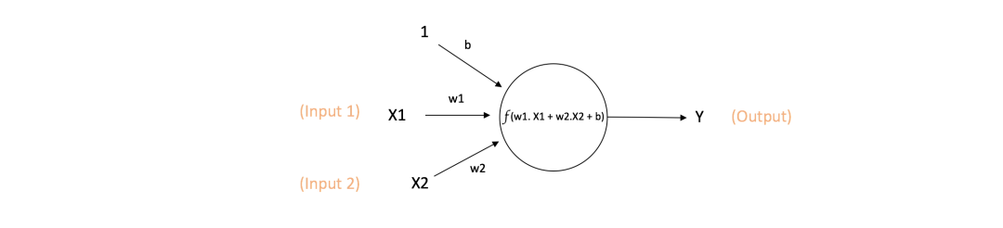
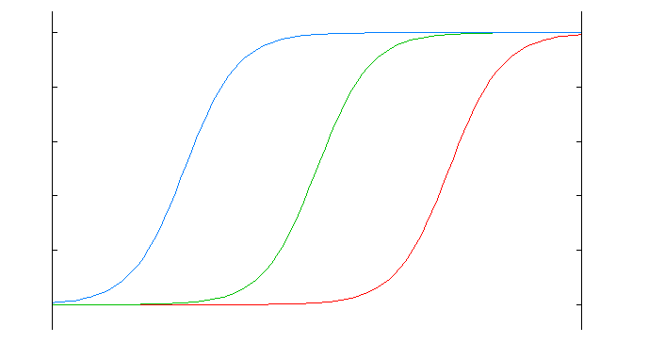
MLP
Y = f(w1*x1+w2*x2+b)
The green curve below is an unbiased activation function, blue is a negative bias, and red is a positive bias.
Notes:
Neuron is the basic unit of artificial neural networks, generally called nodes or unit of a single neuron receives input from other neurons or external sources, and then calculate each input output has a weight, W, it depends on the relative importance of the other input this is the simple description of the single neuron network to accept a weight of W1 and W2 input enter 1 weights are b (called deviation) is the main purpose of bias for each neuron to provide a constant training, mainly through the activation function in the quadrant to move to the left or right to frankly, neuron output 1 how easy it isThe green curve is the unbiased activation function, blue is a negative bias, red is positive bias mathematical expression of the output function of neurons here: Y = f (w1 + w2 * * x1 x2 + b) f (x) is an activation function here is important to note that the activation function does not intend to anything by name activation in the aforementioned neurons in the output, the activation function f (x) is a nonlinear function, because most of the earth's data is not linear mathematics, when the activation function is linear, a double neural network approximation almost all the functionsBut if the activation function is the same activation function,f(x)=x, then this property does not satisfy, then the whole network is essentially a single-layer neural network. Here, I will introduce the most commonly used activation function :Sigmoid

Slide 46

MLP
Sigmoid:
It can transform the output between 0 and 1, which means that if it's a very large negative number it will output 0, and if it's a very large positive number it will output 1. The graphical representation of Sigmoid is shown here.
Notes:
It can convert output between 0 and 1, which means that if it's a very large negative number, it will output 0, and if it's a very large positive number, it will output 1. The Sigmoid icon is shown below.

Slide 47

MLP
.
.
.
.
.
.
.
.
.
Forward structure
Notes:
The forward structure, also known as the feedforward structure, is the earliest and simplest neural network. It consists of multiple nodes (neurons) arranged in multiple layers. Nodes in adjacent layers have connections or edges. All connections have weight. As we can see, the network is divided into three areas: the leftmost input layer, the middle hidden layer, and the rightmost output layer. In short, the input layer is responsible for retrieving external information. It is important to note that there is no computation, only information is passed to the hidden layer. The hidden layer is responsible for most of the computation, but in fact, there may be multiple hidden layers in the feedforward network, or there may be none. The output layer is responsible for partially calculating and transmitting information to the outside world. The reason why we say that feedforward neural network is the simplest network is because: the information only moves in one direction, from the input layer forward, and then through the hidden layer to the output layer, there is no loop or loop in the network.

Slide 48

MLP
Multilayer Perceptron(MLP)
Notes:
MLP contains at least one hidden layer, and you can learn about nonlinear functions. Let's go back to the schematic of the activation function to make it look more like a three-tier neural network structure. So this gives us a set of characteristics X and target Y. Multilayer perceptrons can learn the relationship between features and targets for classification or regression.

Slide 49


MLP
1
1
0
Feature 1 to Feature n
Feature
Notes:
After introducing the mathematical principles learned in MLP, I think I need to explain them more vividly. Please look at these two pictures. The above equation is the scatter-point expression of the training set, y is the label values 0 and 1 in the training set, and X is the characteristic variable. Correspond attack and normal. The figure below is the graph of the neural network after the final learning and fitting. It can be seen that the curve fitted well connects all the characteristic variables. So what are the neurons in each hidden layer doing?

Slide 50



MLP
Feature1 to n
Come from fitting
Notes:
It vividly expresses the fact that each neuron in the hidden layer is assigned a small part in the last continuous curve. The linear fitting of the data is done with the activation function, and the final output is summarized as the perfect curve we just saw.

Slide 51

QDA
no difference in LDA and QDA classification results
Under different covariance matrices, the classification boundaries of LDA and QDA are obviously different, and LDA can no longer accurately classify data
Notes:
Similar to linear discriminant analysis, quadratic discriminant analysis is another linear discriminant analysis algorithm. They have similar algorithm characteristics. The only difference is that the covariance matrices of different types of samples are the same, and the linear discriminant analysis is adopted. When the covariance matrices of samples of different classifications are different, quadratic criterion should be adopted. In order to more clearly understand the difference between LDA and QDA, fixed in the table below shows the covariance matrix and LDA and QDA performance under different covariance matrix difference: can be seen from the diagram, under the fixed covariance matrix, the LDA and QDA did not differ between the classification results (as picture). However, under different covariance matrices, the classification boundaries of LDA and QDA are obviously different, and LDA can no longer accurately classify data (the following two figures). What is the covariance matrix?

Slide 52
QDA
Covariance is defined as the covariance of any two random variables X and Y, denoted as Cov(X,Y), and mathematically defined as:
Cov(X,Y)=E{[ X–E(X)][Y-E(Y) ]}
As X gets larger and larger,Y gets larger and larger, and then Cov(X,Y) > 0;
As X goes down,Y goes down, so does Cov(X,Y) > 0;
As the value of X increases, the value of Y decreases, and then Cov(X,Y) < 0;
As X goes down,Y goes up, and Cov(X,Y) < 0.
Notes:
In statistics, several basic indicators describing sample distribution, such as mean, variance, standard deviation, kurtosis, skewness, maximum, minimum, and extreme, all describe a dimension. If there are more than one dimension in a sample, how can the relationship between the different dimensions be described in addition to the distribution rules for each dimension separately? Covariance is an indicator used to describe the relationship between dimensions. Defined as any covariance of two random variables X and Y, remember to Cov (X, Y), defined as: Cov (X, Y) = {E [X - E (X)] [Y - E (Y)]}, the E (X) E (Y) reflects the average weight of X and Y, it reflects the any two random variables (or any two dimensions). Summed up the law between X and Y is, when two random variables is always following the same trend of covariance, covariance opposite is negative, but we know that the size of the different dimensions may be due to the differences between the value itself is the result of deviation, such as the number of units order is about ten thousand yuan, and user levels may be less than 10, in order to eliminate the differences in digital distribution, it is necessary to standardize covariance, correlation coefficients and the index of standardization (usually expressed in P), its matrix is called a correlation matrix. The basic meaning of system P is as follows: when the P; Zero, X, Y is positively related to the P & lt; Negatively correlated with 0, X, Y, so what happens when P = 0? Does that mean irrelevant? When P is equal to 0, it means that there is no linear correlation between X and Y, but there could be other correlations.

Slide 53
Perceptron
It is a linear classification model of dichotomy;
it is a supervised learning algorithm;
Input is the feature vector of the instance, output is the category of the instance (+1 and -1);
To find a separate hyperplane which can divide an instance in the input space into two classes;
Loss functions are needed to help obtain the hyperplane;
The training data set must be linearly separable (otherwise hyperplane cannot be obtained).
Notes:
So before I introduce SVM, I need to introduce the perceptron, because this is the basis of SVM. The idea of perceptrons is simple, like we have a lot of boys and girls on a platform, and the model of perceptrons is to try to find a straight line that separates all the boys from all the girls. In three dimensions or higher dimensions, the perceptron model is trying to find a hyperplane that separates all the binary categories. What if we can't find such a line? If you can't find it, that means the categories are linearly indivisible, which means that the perceptron model doesn't fit the classification of your data. One of the biggest prerequisites for using perceptrons is that the data is linearly separable. This severely limits the use of perceptrons. But it's important because perceptrons are the basis for many other machine learning algorithms, like neural networks and support vector machines.

Slide 54

Perceptron
Perceptron model: f(X) = sign(w*X + b)
X is features in training dataset, f(X) is the lables;
w and b are called perceptron model parameter;
sign:
eg. One of the hyperplanes of the perceptron model:
(w*X + b) = 0
When (w*X + b) > 0, y = 1;
When (w*X + b) < 0, y = -1;
Notes:
Here is the model function of perceptron. X is the feature of the training data set, f(X) is the label, and Sign is the symbol function. If X is greater than 0, sign returns 1. Equals 0, returns 0; If it is less than 0, it returns -1. The symbol of x determines the return value of the sign function. Assuming that the samples are linearly separable, the objective of perceptron learning is to find the separation hyperplane that can completely separate the positive and negative samples, that is, to find W, B (because Wx + B =0 determines the separation hyperplane). Therefore, we need to determine a learning strategy, that is, define the loss function and minimize it through training samples. Where W is the normal vector of the hyperplane (the vector perpendicular to the plane is the normal vector), and B is the intercept of the hyperplane. This hyperplane divides the sample points into positive and negative categories. When w times X plus b times b0, 0, y is equal to 1, and when w times X plus b is less than 0, y is equal to negative 1

Slide 55







Perceptron
loss function:
Loss function of perceptron:
e.g. The equation of this line: Ax+By+C=0, P(X₀,y₀), (The formula for the distance from the point to the line);
if h(hyperplane) = w*X₀ + b, （ ）；
It satisfies the point of misclassification：：y₀*(w*X₀ + b)< 0 -y₀*(w*X₀ + b)> 0
So,The loss function of perceptron learning is obtained:
M = -(y₁d₁+y₂d₂+y₃d₃+...+y_{i}d_{i} ) = =
Notes:
So let's see where the formula for the loss function comes from. A natural selection of the loss function is the total number of misclassification points, but the loss function defined in this way is not a continuous differentiable function for the parameters W and B and is not easy to optimize. All perceptrons take the total distance between the misclassification point and hyperplane S. Now let's look at an example where, if I have the equation Ax plus By plus C is equal to 0, then the distance from P to the line can be expressed in terms of the distance formula. So if now it's not a straight line formula, it's hyperplane H, and similarly, the distance from p to hyperplane d can be expressed this way. |, |, w, |, | is the L2 norm, which is the sum of the squares of the elements of the vector and then take the square root. Because hyperplane S, for misclassified points, there are two cases, which we mentioned earlier. First, when y = 1, (w) * X + b > 0, when y = 1, (w) * X + b < 0, so for the misclassification points to meet: * (w) * X + b y < 0, namely - y * (w) * X + b > 0, so the misclassification P distance to the hyperplane is to assume that the misclassification of the hyperplane S collection points for M, then all misclassification points to the hyperplane S total distance can be easily derived. We can see from the formula, we're not going to consider 1 over |, |, w|, |, so why not? I now understood as: 1. Determine the separating hyperplane is through the normal vector w and intercept b to determine, | | w | | size does not have any effect on w direction, so it can be fixed | | w | | 1 or not consider | | w | |. 2. Perceptron is misclassification driven, and to determine whether the sample point is a misclassification point, only the positive and negative values of [-y*(w*X + b)] need to be judged, while 1/||w|| is not affected

Slide 56



Perceptron
Stochastic gradient descent method (SGD) was used to solve the optimization problem of the loss function:
Optimal object：
The gradient of the loss function L(w,b) is:
A misclassification point (x, y) is randomly selected to update w and b:
Notes:
Here, the stochastic gradient descent method (SGD) is adopted to solve the optimization problem of loss function. First, the optimization objective is to find the minimum loss function by adjusting the values of W and B. First of all, take the partial with respect to w and B, and here the inverted triangle means take the derivative of the function in the orthogonal directions and then multiply it by the unit vector in each direction. Then, randomly selected from a misclassification point (x, y), to solve the parameter w, b update: minimization process all the misclassification in the case that is not a point of the gradient descent, but a randomly selected from a point of misclassification gradient descent. Here the learn rate, which means the distance per descent. New w and B values can be obtained through the learning rate. In conclusion, the original form of perception machine learning algorithm is a: input: training set T, vector output: w, b

Slide 57



Linear SVM algorithm
On the basis of the perceptron, the kernel function is added to map the original feature to another high dimensional space, which solves the problem of linear inseparability of the original data set.
Eg:
X+b=0
Notes:
After introducing the stochastic gradient descent algorithm, let's talk about SVM. On the basis of the perceptron, SVM adds kernel function to map the original feature to another high dimensional space, thus solving the problem of linear inseparability of the original data set. So how do you solve this? Here's a simple example. Let's say my original input vector is one-dimensional, 0<x<1 category is 1, and I'll call it -1 for everything else. In this case, it is impossible to find a separated hyperplane in one dimensional space; If we map the original one-dimensional eigenspace to the two-dimensional eigenspace X2 and x, then we can find the separated hyperplane X2 minus x is equal to 0. The way to find a hyperplane is the same principle as the perceptron. When X2 minus X is less than 0, we can call it class 1, and when X2 minus X> is 0, we can call it class 0. By mapping x2-x =0 back to the original eigenspace, we know that the instance class between 0 and 1 is 1, and the rest of the space (less than 0 and greater than 1) is 0. The problem of linear inseparability in low dimensional space can be solved by using feature mapping. When the original space is linearly indivisible, it can be mapped to a higher dimensional space and converted to a linearly separable problem. As for the specific linear classification process, we have introduced in detail the process of loss function using gradient descent to obtain the optimal solution in perceptron, so it will not be repeated here.

Slide 58

5. Score and Evaluate the algorithms
Approach 1 - Using 12 Attack Types（Each attack uses the 4 heightest features）
Notes:
Nine different machine learning methods were applied to 12 different types of attacks, and the results are shown in the table. In the results shown in the table, the maximum and minimum scores are emphasized as follows: the maximum score is bold, the minimum score is underlined and italicized. In the algorithm result, if equality exists in f-measure, to eliminate equality, the following values are checked respectively :accuracy, precision, recall and time. When looking at the results, it can be noted that the Random Forest, KNN, ID3 and Adaboost algorithms have achieved a success rate of more than 90% in almost all types of attack detection. Of the four algorithms, the most successful was ID3, which completed seven of the 12 tasks and scored the highest. In fact, ID3 scored highest on at least one of the seven tasks (DDoS, DoS GoldenEye, DoS Hulk, PortScan, SSHPatator, and Web Attack). However, it has a shorter processing time and is superior to other algorithms. Out of the 12 tasks, the naive Bayesian algorithm with the smallest F measure ranked last among the six tasks. However, it is also necessary to refer to QDA here in naive Bayes. Because in almost all of these six tasks, QDA scores were very close to those of naive Bayes.

Slide 59

5.Score and Evaluate the algorithms
Approach 2 - Using Two Groups: Attack and Benign（Using Features Selection for all_data.csv）
Notes:
The table above shows the results obtained using the 18 attributes extracted from ALL_data. As can be seen from the table, the algorithm with the highest performance is KNN, with an F1-score of 0.93. After that, AdaBoost and ID3 were only 0.90 and 0.91. However, ID3 is much faster than Adaboost, so it takes precedence over this feature. The algorithm with the lowest score is QDA, with a score of 0.31. The QDA score was about 0.4 points lower than the closest algorithms (naive Bayes and MLP). In this method based on tag value, it can be seen that KNN is the optimal algorithm.

Slide 60
6.Conclusion and Future Work
Conclusion: Based on the above two methods, it can be seen that KNN and ID3 of the 9 algorithms have the best performance for the data set.
Future Work: This work is open to future improvements.
In this study, a data set consisting of CSV files containing features obtained from the network flow was used as the training and test data. Unfortunately, this method is not practically viable in real systems. However, this problem can be solved by adding a module that catches real network data and makes it workable with the machine learning algorithm.
Another point was that during this study, various machine learning methods were applied independently from each other and experimental results were obtained. However, this method has a weak practical applicability in real life. In order to deal with this problem, a multi-layered / hierarchical machine learning structure can be designed. Moreover, thanks to such a structure, it is possible to save time, CPU power and memory.
Notes:
The purpose of this project is to detect network anomalies using machine learning methods. In this case, CICIDS2017 is used as a data set because of its relatively new, broad diversity of attacks and various network protocols (such as mail services, SSH, FTP, HTTP, and HTTPS). This dataset contains more than 80 features that define the network flow and is real data, so it is very practical. Based on the above two methods, it can be seen that KNN and ID3 of the 9 algorithms have the best performance for the data set. This work needs further improvement. In this study, we used a data set consisting of A CSV file containing network flow characteristics as training data and test data. Unfortunately, this approach doesn't work in real systems. However, this problem can be solved by adding a module that captures real network data and combines it with machine learning algorithms. Another point is that in this study, various machine learning methods are applied independently and experimental results are obtained. However, the practical application of this method in real life is weak. To solve this problem, a multi-layered/layered machine learning structure can be designed. In addition, with such a structure, time savings, CPU power, and memory are possible.

Slide 61
Thank you
Notes:
Thank you everyone, here is my whole project presentation. As for the project itself, if you still want to continue to communicate with me, please feel free to contact me through email.

